Slide 1
British Airways
Predictive model and its results
2022-11-09

Slide 2
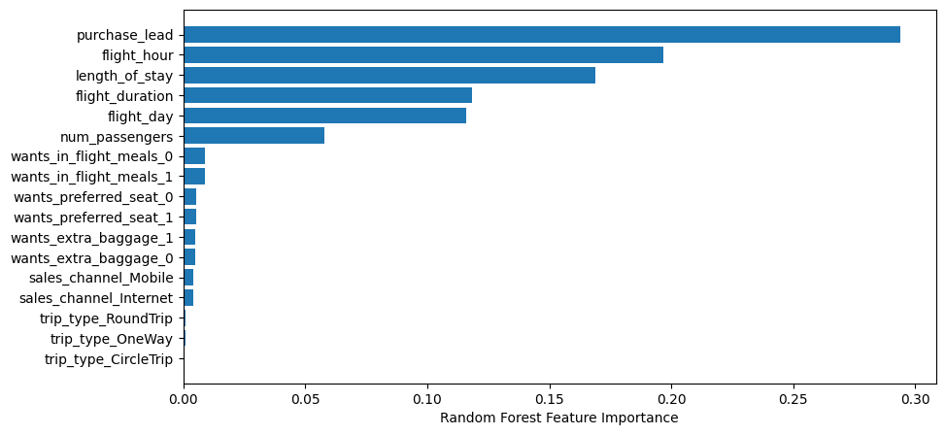
Predictive modelling results
Recall Rate
73%
Precision
83%
Chance of predicting true successful bookings.
Will be predicted as actually completed bookings out of all successfully completed bookings.
Chance of predicting true successful bookings.
73% Chance of predicting true incomplete bookings correctly.
Accuracy of the model predicting successful or incomplete booking is
Accuracy
90%
Accuracy of the model predicting successful or incomplete booking is
We are concerned with not predicting the successful bookings correctly. Imbalance dataset drives higher accuracy but it does not accurately predict the successful bookings. Dataset was balanced with equal number of bookings by generating synthetic data and then predictions were made.
Top features that can drive successful flight bookings.

